Slide 1
Programming in Logic: Prolog
Ahmad Hassanat & Ahmad Tarawneh

Slide 2


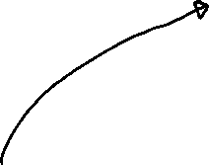
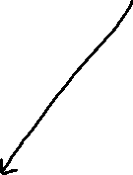





Prolog
Prolog is a logic programming language associated with artificial intelligence.
Prolog has its roots in first-order logic, a formal logic, and unlike many other programming languages, Prolog is intended primarily as a declarative programming language:
the program logic is expressed in terms of relations, represented as facts and rules

Slide 3
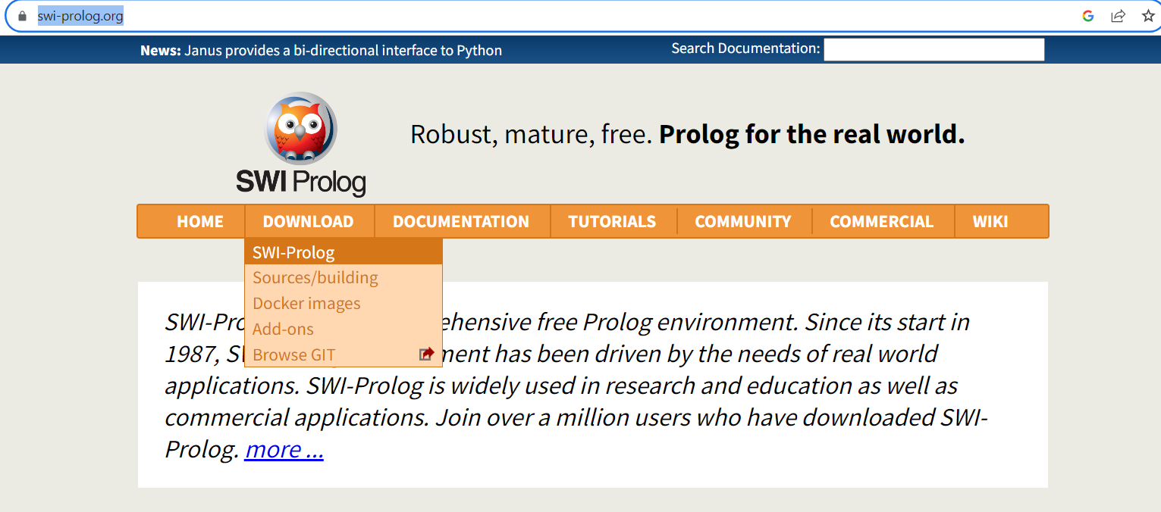
Prolog installation
To install prolog you can visit the following link:
https://www.swi-prolog.org/

Slide 4
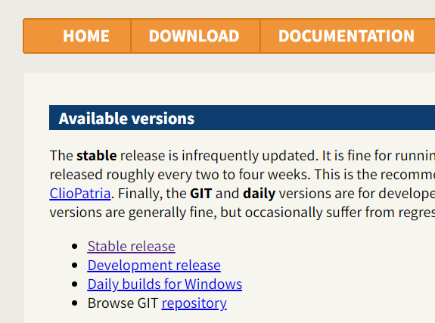



Slide 5
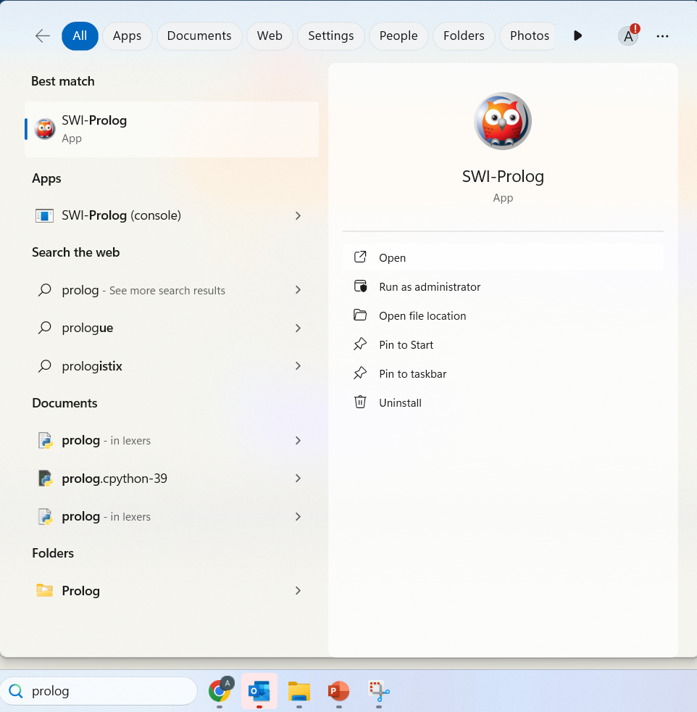
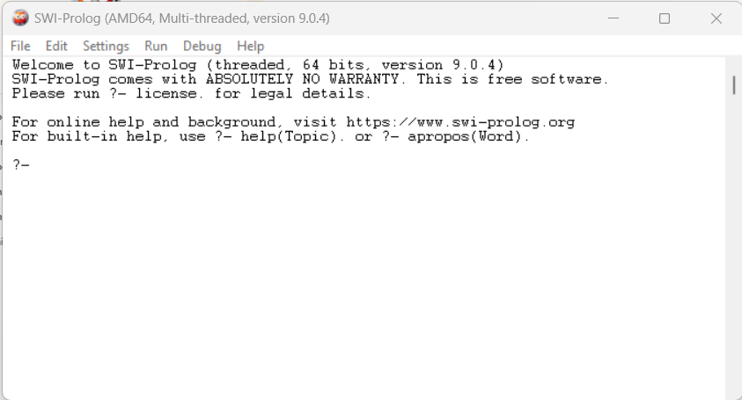

Slide 6
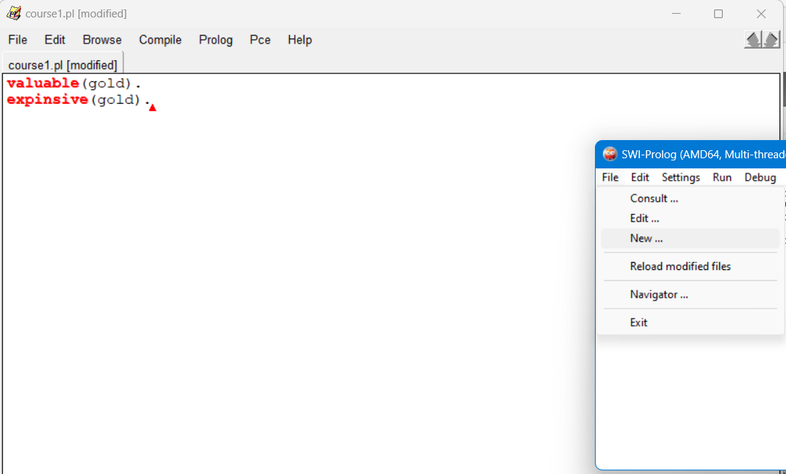

Slide 7

Prolog Basics - Revisited
Prolog program consists of facts and rules. animal(lion). animal(sparrow). hasfeathers(sparrow). bird(X) :- animal(X), hasfeathers(X).
“Run” by asking questions or queries. Or (using logic terminology) by setting a goal for Prolog to try to prove: To find out if something is true: ?- bird(sparrow). yes
Or to find a value of a variable that makes it true: ?- bird(What). What = sparrow

Slide 8


Prolog Execution
A Prolog rule consists of a head and a body.
a(X) :- b(X), c(X).
When Prolog tries to answer a query (prove a goal) it does so by trying to match the goal to the head of the rule. This might result in some variables getting bound.
?- a(thing).
a(thing) MATCHES a(X) so X is bound to the value “thing”.
Now it tries to prove the goals in the body of the rule, using these variable bindings::
b(thing) and c(thing)
head
body

Slide 9
Example
likes(mary, X) :- strong(X), handsome(X).
strong(Y) :- tall(Y).
tall(john).
handsome(john).
?- likes(mary, john).
MATCHES likes(mary, john) to head of rule 1, with X=john.
Sets strong(john), handsome(john) as new goals.
Tries to prove strong(john).
MATCHES head of rule 2. Y=john.
Tries to prove tall(john).
MATCHES a fact. So proved.
Tries to prove handsome(john).
MATCHES a fact, So proved.

Slide 10




Example: Using Prolog Trace
| ?- likes(mary, john).
1 1 Call: likes(mary,john) ?
2 2 Call: strong(john) ?
3 3 Call: tall(john) ?
3 3 Exit: tall(john) ?
2 2 Exit: strong(john) ?
4 2 Call: handsome(john) ?
4 2 Exit: handsome(john) ?
1 1 Exit: likes(mary,john) ?
yes

Slide 11
Can also represent this as a “proof tree”.
likes(mary, john)
Using rule 1
strong(john)
handsome(john)
Using rule 2
True fact
tall(john)
True fact

Slide 12

Prolog facts
المعامل (functor) هو اسم العلاقة أو الدالة.
المعاملات (arguments) هي القيم التي تُمرر إلى هذه العلاقة أو الدالة.
Prolog facts can in fact be a little more complex.
Arguments may be any “prolog term”.
This includes “structured objects”, consisting of a functor and some arguments.
The arguments must be prolog terms.
This allows facts like:
likes(fatherOf(fred), motherOf(joe)). owns(mother(fred),book(title(l), author(t))).
functor
arguments
functor
argument

Slide 13
Operators
Operator | Symbol in Prolog
AND | ,
OR | ;
NOT | \+
-> | :-

Slide 14
Prolog Matching
With more complex terms, have to look more carefully at how Prolog matches expressions.
Consider:
likes(fatherOf(fred), motherOf(joe)).
?- likes(fatherOf(fred), motherOf(X)). (whose mother does fred’s father like?).
MATCHING the expressions gives X=joe.
But: ?- likes(fatherOf(fred), X). (who does fred’s father like?)
X = motherOf(joe)
Prolog must find variable bindings that make the two matched expressions identical.

Slide 15
Prolog Matching
We can try out Prolog matching at the prompt by using the “=“ operator, which in Prolog means “matches”.
?- a(X) = a(1).
X = 1 ?
yes
| ?- likes(f(A), m(A)) = likes(f(john), m(john)).
A = john ?
yes
| ?- likes(f(A), m(A)) = likes(f(john), m(mary)).
no Doesn’t match as can’t have A=john AND A=mary.
| ?- 1+1 = 2.
No Doesn’t match as prolog doesn’t evaluate arithmetic expressions!

Slide 16

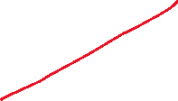


To think about:
Which of these will succeed? What will be the variable bindings?
f(1) = f(A).
f(A, A) = f(1, 2).
a(b(abc), c(A)) = a(b(B), c(def)).
a(b(abc), X) = a(Y, c(def)).
a(b(abc), c(X)) = a(b(X), c(def)).

Slide 17
Backtracking
How does Prolog systematically go through rules and facts to answer queries?
Process is known as backtracking.
Prolog goes through facts/rules top to bottom looking for facts or rule heads which match the goal.
If a rule fails as can’t prove body, Prolog will try next rule/fact matching current goal.
If can’t find ANY way to prove current goal, Prolog will retry the previous goal, to see if it can be solved another way.

Slide 18
Simple example, facts only.
bird(type(sparrow), name(steve)).
bird(type(penguin), name(tweety)).
bird(type(penguin), name(percy)).
?- bird(type(penguin), name(X)).
X = tweety ;
X = percy ;
no
Note: Here we use “;” to ask it to look for other solutions,
which forces backtracking.

Slide 19
Example: Two rules
carriesUmbrella(X) :- rainingOn(X).
carriesUmbrella(X) :- inScotland(X).
inScotland(fred).
?- carriesUmbrella(fred).
First tries rule 1. This doesn’t work out, as rainingOn(fred) can not be proved, so it continues through Prolog rules/facts and tries rule 2. This succeeds.

Slide 20
One rule, several facts.
likes(mary, X) :- tall(X), handsome(X). tall(john). tall(jim). handsome(jim).
?- likes(mary, Who).
Matches head of rule with X=Who (binding two variables to same value).
Tries to satisfy tall(Who).
tall(John) succeeds.
Tries to satisfy handsome(john).
This fails.
So backtracks and retries tall(Who).
Succeeds with Who=jim
etc.

Slide 21
Another one..
?- bird(B).
Matches with head of first rule.
Tries to satisfy animal(B).
Matches animal(leo).
Tries to satisfy hasFeathers(leo).
FAILS, so GOES BACK to try
animal(B) again.
Maches animal(percy).
Tries hasFeathers(percy).
Succeeds, so bird(B) succeeds/
B = percy ;
Going back and trying later animal facts:
B = peter;
And trying later “bird” fact:
B = freddy.
animal(leo).
animal(tweety).
animal(percy).
animal(peter).
hasFeathers(percy).
hasFeathers(peter).
bird(X) :-
animal(X),
hasFeathers(X).
bird(freddy).

Slide 22
Summary
Matching:
Prolog tries to prove goals by matching them with rules/facts.
Tries to find variable bindings making expressions identical.
Backtracking
Prolog goes through facts/rules from top to bottom to try to find matching rules or facts.
But keeps track of where it has got to, and when anything fails it goes back and re-tries the last goal it proved, finding another way to prove it using facts/rules later in the program.

Slide 23
Exercises
Which match? What are the bindings?
a(1, 2) = a(X, X).
a(X, 3) = a(4, Y).
1 + 2 = 3.
a(a(3, X)) = a(Y).
a(X, Y) = a(1, X).

Slide 24
What are the solutions to the following, and what order are they given?
aeroplane(concorde).
aeroplane(jumbo).
on(fred, concorde).
on(jim, no18bus).
bird(percy).
animal(leo).
animal(tweety).
animal(peter).
hasFeathers(tweety).
hasFeathers(peter).
flies(X) :- bird(X).
flies(X) :- areoplane(X).
flies(X) :- on(X, Y), aeroplane(Y).
bird(X) :- animal(X), hasFeathers(X).
Query:
?- flies(X).

